Slide 1
THE TUTORIAL BUILDER SYSTEM
George Cherian-6408
Neil Chettiar-6409
Omkar Narkar-6434

Slide 2
Problem Statement
Data in today's world is spread out over thousands of different places
No limit to the number of places holding information

Slide 3
Problem Statement
No guarantee to the grade or relevance of the information
Combine all data to a single location after judging relevant information.

Slide 4
Aims And Objectives
Create a system to prepare tutorials based on input subject and stream
Create a user centric easy to use system
Help the user get information from multiple locations in a single location

Slide 5
Aims And Objectives
Crawl the web and gather information efficiently
Prepare the information in the best possible way.

Slide 6
Scope
Can be extended across multiple branches
Can be used as a massive time saver by any one looking for data on any project.

Slide 7
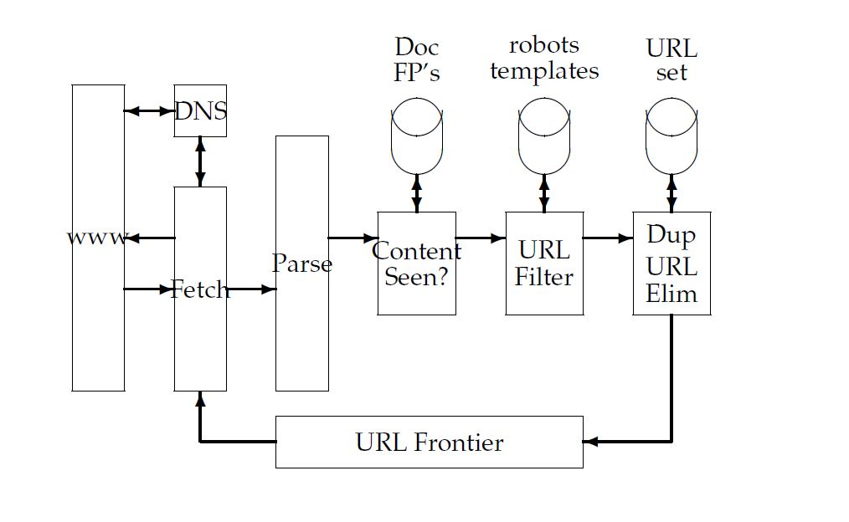
Literature Survey
Web Crawler: Architecture

Slide 8
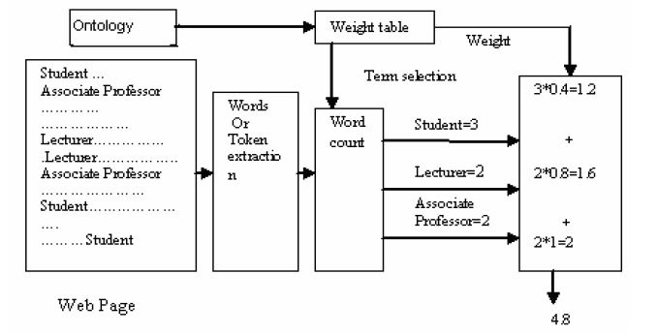
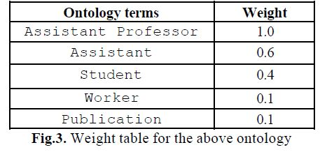
Literature Survey
Web Crawler: Added Functionality

Slide 9
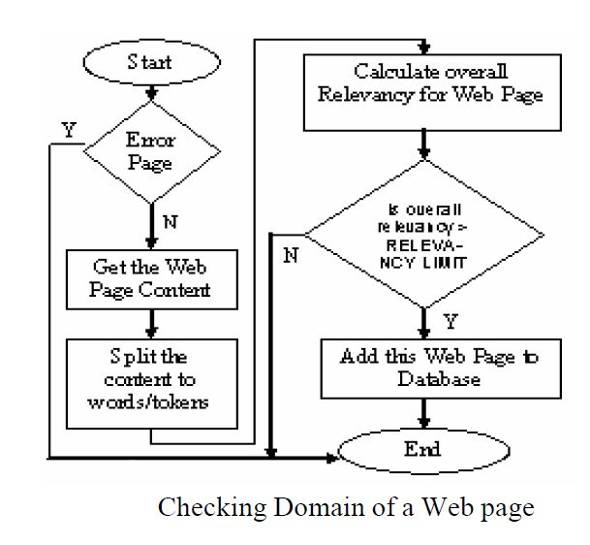
Literature Survey
Web Crawler: Added Functionality

Slide 10
Literature Survey
Data Ranking:
Ease of Understandability
Diagrams
Descriptivity
Examples and solved problems
Comments

Slide 11
Literature Survey
Machine Learning
Ease of Understandability:
To determine the EoU score, we used a text corpus with around 6000 words and their frequency.
The complexity of the words are inversely proportional to its complexity.
Segregated the text corpus into 3 different sections: Easy words, medium words and Difficult words.

Slide 12
Literature Survey
Machine Learning
Comments:
He is a disease to every team he has gone to.
Converting to SMF is a headache.
The concert left me cold.
That guy is such a pain.
Early symptoms of the disease include severe headaches, red eyes, fevers and cold chills, body pain, and vomiting.
We used the MPQA text corpus.

Slide 13
Proposed System
User input centric tutorial builder
Takes input from user in the form of subject and stream
Crawls web for relevant data
Formulates and returns Tutorial to the user

Slide 14
Requirement Analysis Functional Requirements
User should be able to search for subjects in various streams with default stream always being chosen stream
User should be able to specify a topic within a subject to search for
If user is not sure of which topic he wants or wants multiple topics in a subject the system should provide the user with a list of all topics under the system.
User should be able to view and sort search history

Slide 15
Requirement Analysis Non-Functional Requirements
Searches should be fast
Details of every user should be private unless otherwise specified by the user.
Data should be coherent
Tutorials should be easy to understand.
System should be reliable
System should not be vulnerable to attacks.

Slide 16
Methodology
The user will first register themselves with system
The user can then login any time
To get a tutorial the user will enter the subject name on which they want the tutorial
the stream will be default but can be changed

Slide 17
Methodology
Select a topic or let system give a list of topics after crawling.
Crawlers pick up stream relevant and subject relevant data.
System will rank the data according to 5 criteria

Slide 18
Methodology Ranking
Ease of Understandability
Text corpus are used to generate an average understandability score for every document
EoU Score=(avg. understandability % of document)
Diagrams
Average score of total diagrams to length of document is found and applied to the ranking.
Diag. Score=(No Of Diagrams/doc length)
Diag Score>=5 ,Then Discard Document
Else Accept and continue

Slide 19
Methodology Ranking
Examples and Solved Problems
Examples or solved problems are very clearly defined and can be easily found because they are preceded by very clear demarcations like “eg:”,”Solving”,etc
Ex. Score=(No of Examples)
Descriptivity
The words “ like”, “can be compared to”, “is similar to”, “works like a”, etc.
Desc. Score= ( No of Descriptive Parts)
Comments
Strength of comments and sentiment behind them can be understood
Com. Score= ((Weight of Positive Comments)- (Weight Of Negative comments))

Slide 20
Methodology Ranking
The total score of the document is considered to be a weighted sum of all the scores
The weights are decided on the perceived importance of the criteria
Total Score= ((nxEoUScore)+(mx(doc lengthxDiag Score))+(pxExScore)+(pxDes Score)+(qx Com Score))
m>n>p>q
Data with highest score is chosen for the user.

Slide 21
Methodology
Data is returned or a list of topics.
The user will have all the data in every topic ready.
The user will also have the option to view their search history
And access previous searches.

Slide 22
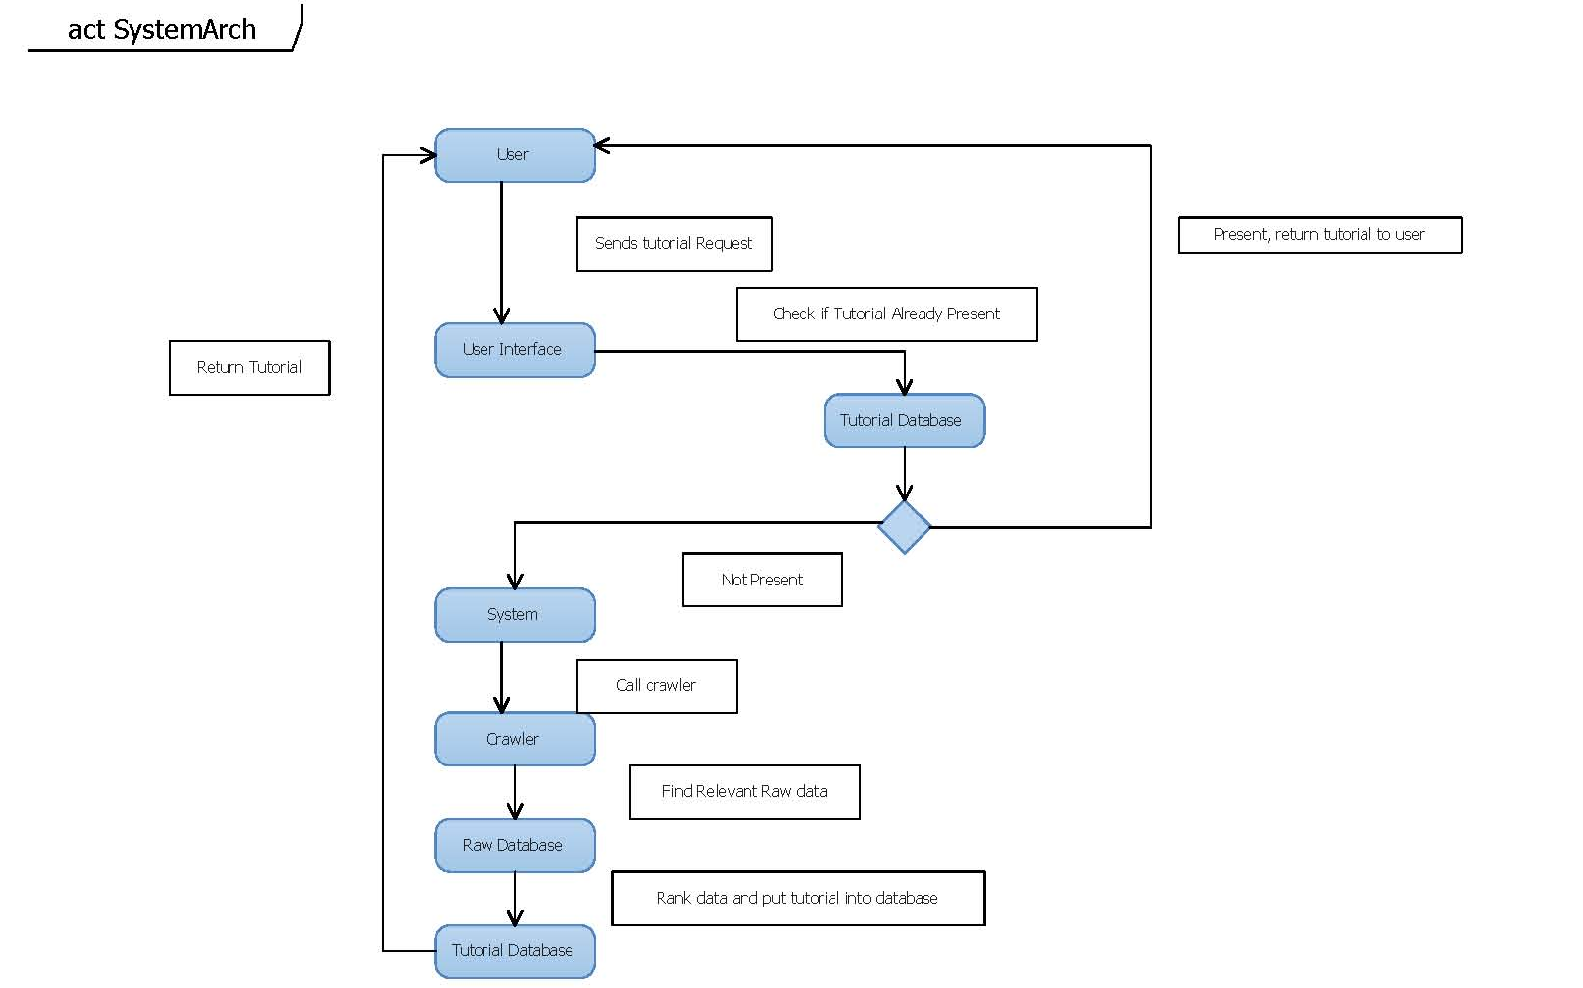
System Architecture

Slide 23
System Architecture
User Interface
Tutorial Database/Cache
System Controller
Crawler
Raw Database
User

Slide 24
WebCrawler: Implementation
Usually when we use Google for web searches, personalised results are shown.
Web crawler is automated program and doesn’t have personality.
So until we give a personality of a known web browser to the web crawler, few hosts refuse the connection request.
Here we have used Mozilla 5.0 to personalise our web crawler.
Now every host grants access to our web crawler and continuous bwe crawling can be performed if resources allow it.

Slide 25
WebCrawler: Implementation
Current implementation of web crawler works in two parts.
First one works on finding links which contain relevant data and store them in database.
While second one works on extracting only the data part from each page.
Here web crawlers are implemented in Python language on the version 2.7.0
Relevance is found with help of Google at this time in the first crawler part.

Slide 26
WebCrawler: Implementation
Web crawler development was eased by help of already available libraries which cuts down development time drastically
We used libraries such as ‘urllib’ ‘BeautifulSoup’ which made our work easy.
Current relevant web crawling functionality is based on Google.
We seek to develop our own focused web crawler if resources available to us permit that.

Slide 27
Ranking Example-1
EoU(Ease Of Understandability) Score=4.935
Diag(Diagram) Score=0.125
Ex (Example) Score=0
Desc(Descriptivity) Score=10
Com (Comments)Score=0
Total Score=49.35+20+0+50+0=119.35
Assuming n=10,m=10,p=5,q=3 for all the following examples

Slide 28
Ranking Example-2
EoU(Ease Of Understandability) Score=3.1908
Diag(Diagram) Score=0.3125
Ex (Example) Score=1
Desc(Descriptivity) Score=9
Com (Comments)Score=0
Total Score=31.908+50+5+45+0=131.908
Assuming n=10,m=10,p=5,q=3 for all the following examples

Slide 29
Ranking Example-3
EoU(Ease Of Understandability) Score=6.3218
Diag(Diagram) Score=0.818
Ex (Example) Score=4
Desc(Descriptivity) Score=12
Com (Comments)Score=0
Total Score=63.218+90+20+60+0=233.218
Assuming n=10,m=10,p=5,q=3 for all the following examples

Slide 30
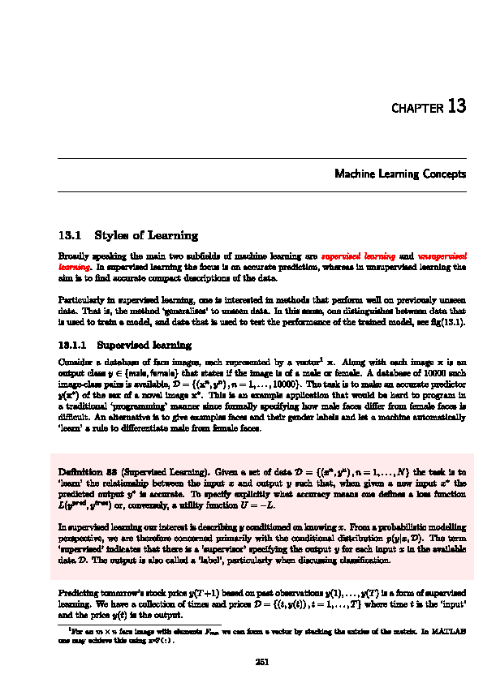
Ranking Example-4
EoU(Ease Of Understandability) Score=4.682
Diag(Diagram) Score=0.4
Ex (Example) Score=3
Desc(Descriptivity) Score=9
Com (Comments)Score=0
Total Score=46.82+20+15+45+0=126.82
Assuming n=10,m=10,p=5,q=3 for all the following examples

Slide 31
Ranking Example-5
EoU(Ease Of Understandability) Score=4.908
Diag(Diagram) Score=0.222
Ex (Example) Score=0
Desc(Descriptivity) Score=12
Com (Comments)Score=0
Total Score=49.08+40+0+60+0=149.08
Assuming n=10,m=10,p=5,q=3 for all the following examples

Slide 32
Future Scope
We can use machine learning to extract only relevant information from pages making the ranking and crawling more efficient.
The system can learn data from the various data taken and create a tutorial of its own
The project can be expanded to take data from all stream rather than just computer science

Slide 33
Conclusion
The system architecture and the general implementation details have been figured out.
The crawler system to take information from the internet and put the data into a new database has been studied and architectures for that system have also been illustrated
The relevant text corpuses have been found and implemented for machine learning.
The logic for ranking of the documents has been outlined and demonstrated.

Slide 34
THE END

